Slide 1
Brcm college of engineering and technology
CELEBRATING
World engineers day
15 September
th

Slide 2
About the project
WEBER’S
( The Educational Website )

Slide 3
Content:-
Factors About Making Any Websites.
Different Types of Websites on The Internet.
Explanation About Our Educational Website WEBER’S.

Slide 4
Factors About Making Any Websites
In this era of websites making, there are mainly three types of web developers:-
Front-end
Back-end
Full Stack
It is the look of websites, which we can see. Some of the Languages are:-
It stores the data of any websites. Some of the Languages are:-
The Person, who are Full Stack Developers, basically they uses all these web languages which is used by front-end & back-end developers e.g. HTML, CSS, JavaScript, Python, Java, PHP, etc.
HTML
CSS
JavaScript
FRAMEWORKS
Python
Java
PHP
JavaScript

Slide 5
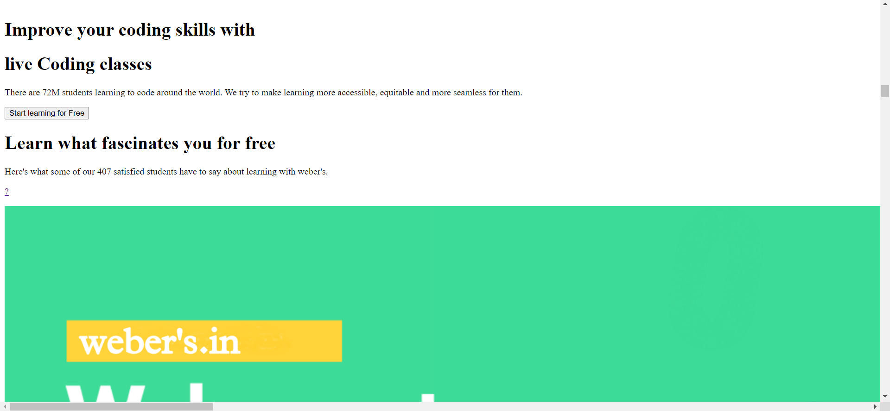
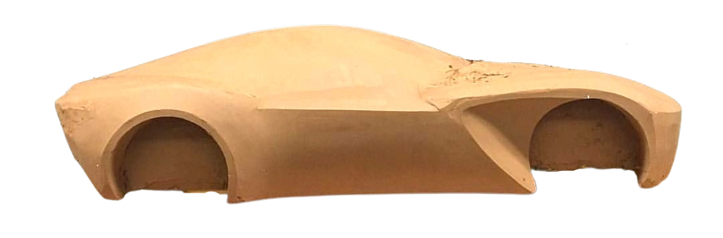
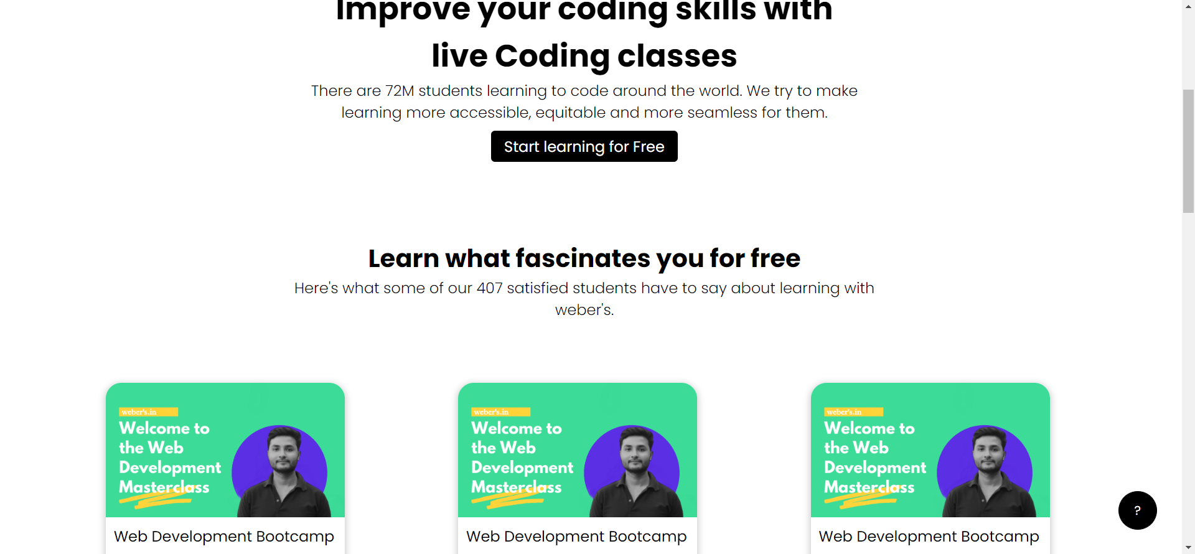
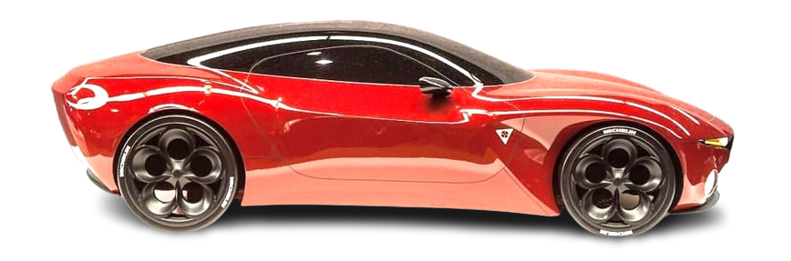
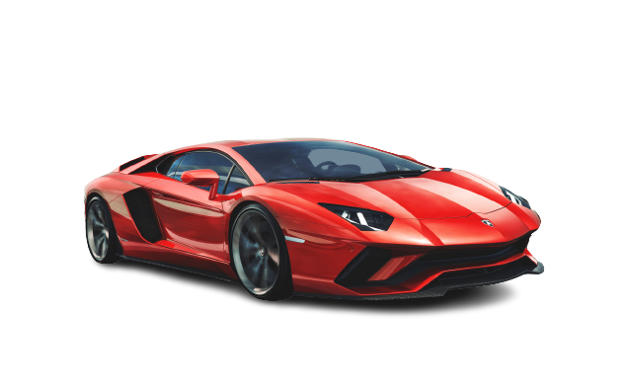
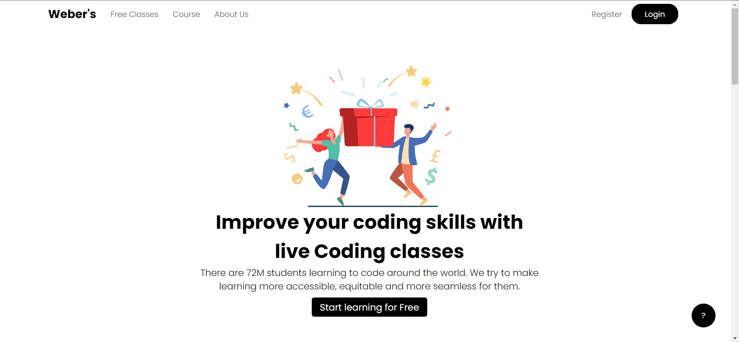
Making the body parts phase
( HTML )
Styling the body parts phase for good looking
( CSS )
Adding some features for performance
( JAVASCRPT )

Slide 6
Different Types of Websites available on Internet
We are going to discuss about some types of websites:-
1. Educational Website
2. Social media Website
3. E-commerce Website
4. Blog Website
5. Entertainment Website
6. Portfolio

Slide 7
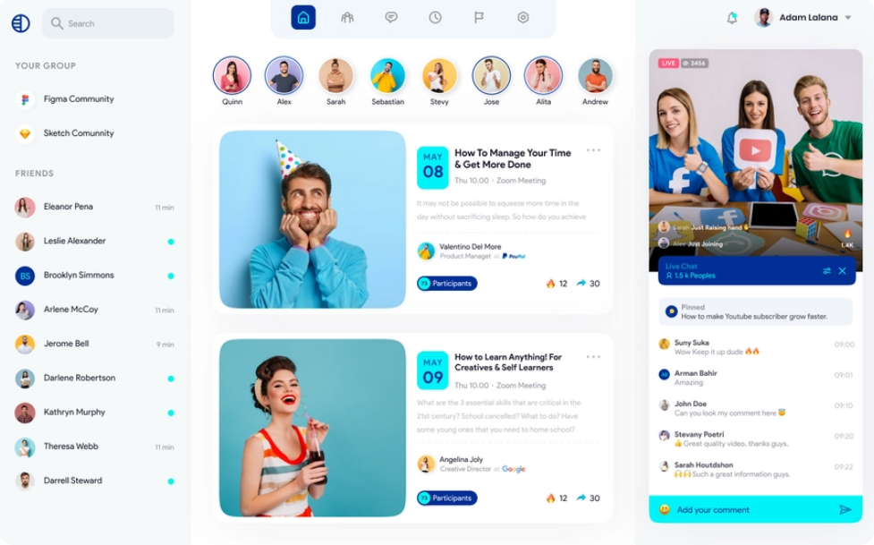
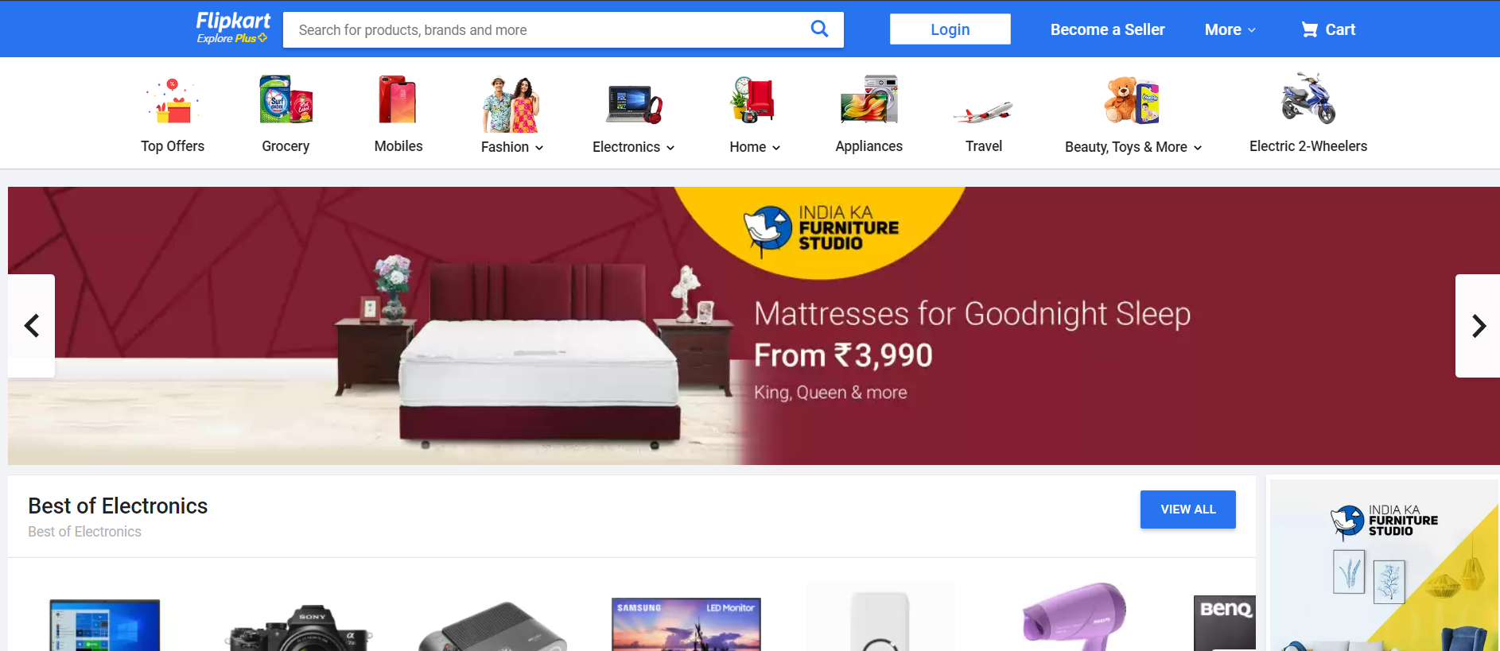
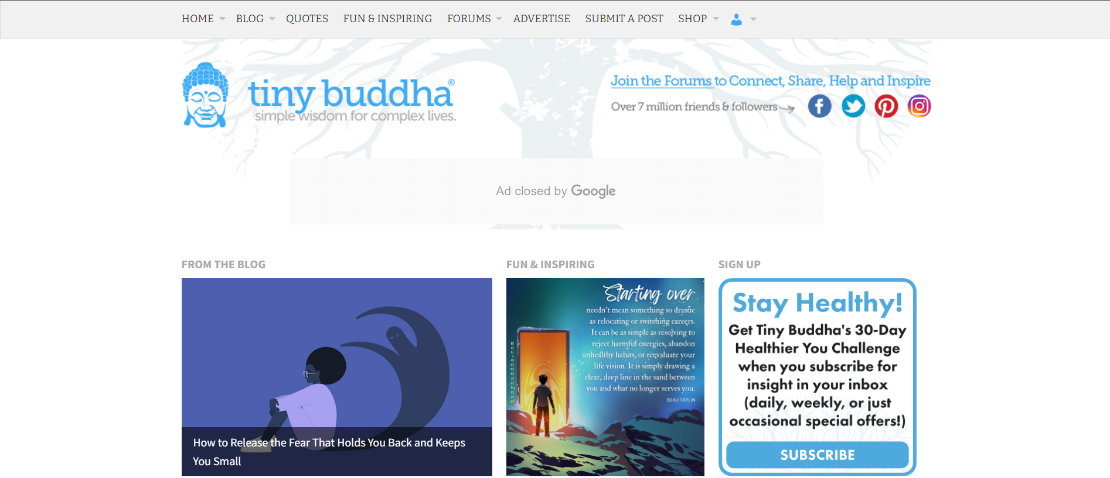
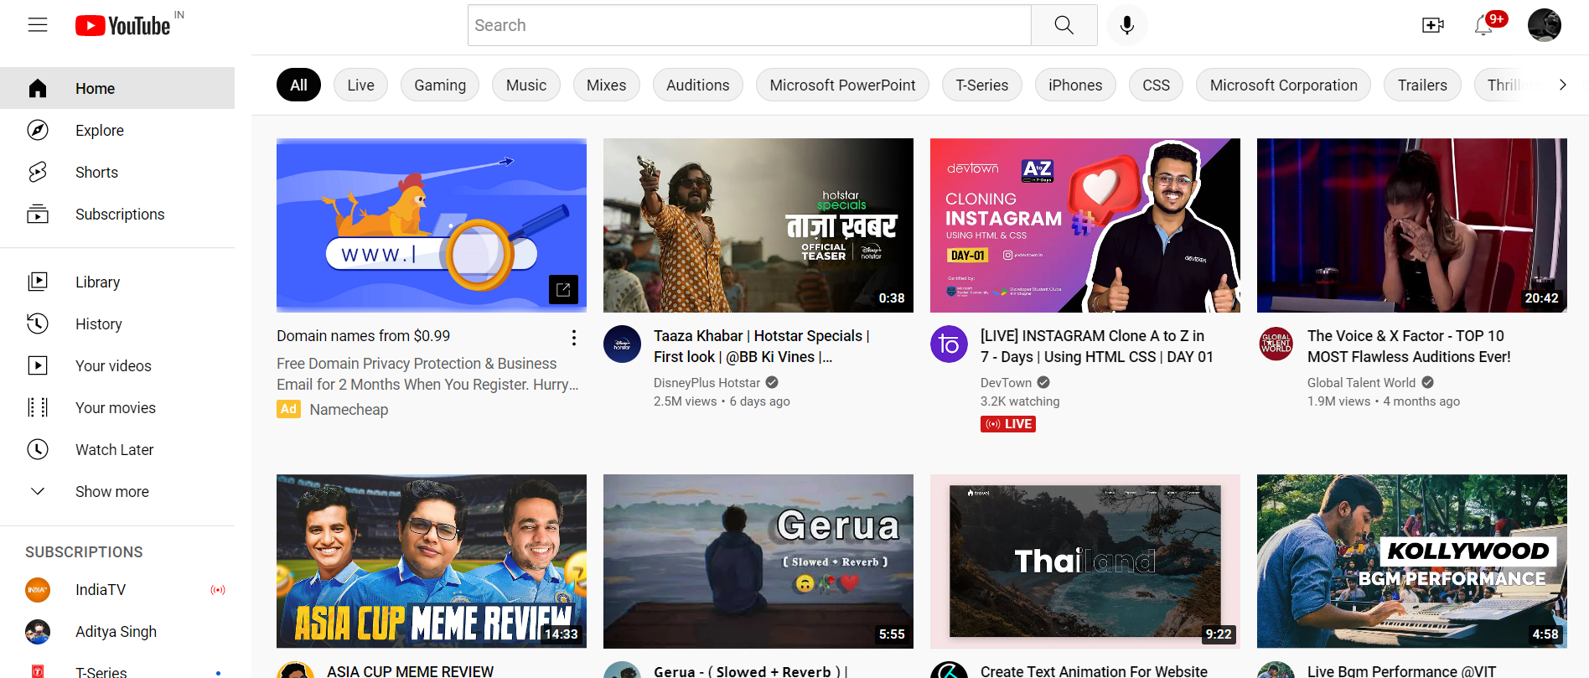
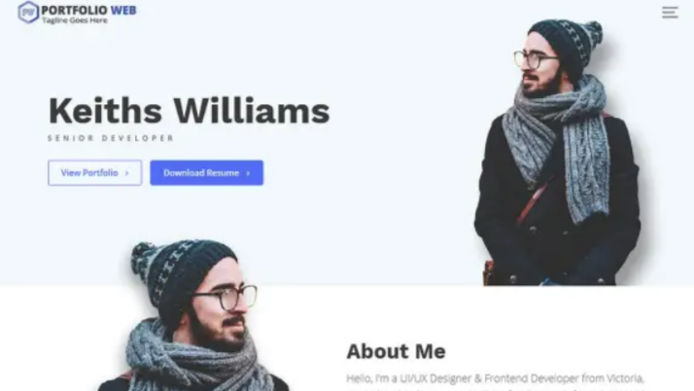
Educational Website
Social Media Website
E-commerce Website
It is used for educational purpose.
It helps to connect each other virtually.
It is used for ‘SELL or BUY’ any product.
Blog Website
Entertainment Website
Portfolio Website
Provide information about your journals.
It is used for Entertainment purpose.
It tells about you, your technical skills.

Slide 8
Explanation About Our Educational Website
Weber’s
Features and Uniqueness in Our Website:-
Learning with variety of educational materials.
We provide all type of courses from basic to advance.
We provide project each weeks.
We also provide free webinar every week with its participation certificate.
Student can watch courses in both English or Hindi language.
One to One mentor for every student.
After the completion of course, we provide certificate of that course for free.

Slide 9
LET’S MOVE TO OUR WEBSITE DEMO

